Slide 1
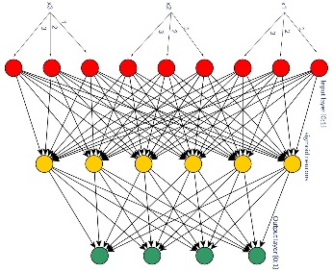
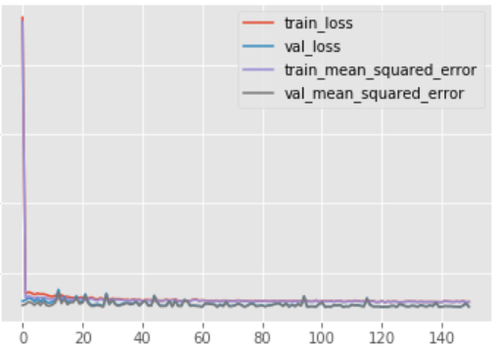


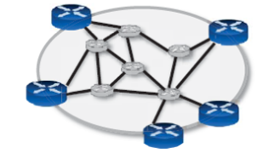
Estimating QoS (delay) with ML techniques
Simulation tool: ns3 together with C++. Alternative: OMNeT++.
To collect a matrix of M rows, the simulation is run for M periods
During each period, for each node the traffic, topological and routing features are collected
Model
Results
Data
Shared repos
Knowledge Defined Networking: http://knowledgedefinednetworking.org
Collection of repositories related to the work
Graph Neural Networks (GNN)
RouteNet is based on MPNN (Message Passing Neural Network) GNN architecture. Learns how to model hidden features (path and link states) that describe the relationship between delay, network topology and routing policy. Able to generalize delay starting from models trained on network with different number of nodes, topology and routing policy. The great generalization results obtained are provided.
Graph Convolutional Networks (GCN)
No current implementation exist in the networking field. Semi-supervised architecture. They are an application of convolutional neural network when data are represented as a graph, so they seem to fit well the networking issue. The main aspect to be considered is their capability of categorizing nodes depending on the graph structure thanks to graph structure info (eg: adjacency matrix). Described to work well when homophile property should be exploited.
Space exploration
Topology
Traffic characteristic
Number of packet drops
Transferred data in the period (Kb/s)
Delay per packet (sec/bit), target
Routing policy
Analyze current state-of-art
Neural Network
Starting point for space exploration and guidelines
DeepQ (Deep Learning)
Current state-of-the-art DL techniques applied to QoS estimation

